Slide 1
UncLe-SLAM：将不确定性学习用于
密集神经SLAM
UncLe-SLAM: Uncertainty Learning for Dense Neural SLAM
主 讲 人：K.Fire
高校：某知名双非大学
公 众 号：3D视觉工坊

Slide 2
Outline
1
Introduction
2
Method
3
Experiments
4
Conclusion

Slide 3
1
Introduction

Slide 4
Introduction
Purpose:
Main Contributions:
1. Neural scene representations have taken over the 3D reconstruction and SLAM field by storm
2.However, their camera tracking performance is typically inferior to the one of traditional sparse methods that rely on feature point matching
a) A robust approach for estimating aleatoric depth uncertainty for the single and multi-sensor case is proposed. The introduced framework is robust, accurate and can be directly integrated into a dense SLAM system without the need for ground truth depth or 3D.
b) In the single depth sensor case, we show that our uncertainty-driven approach often improves on standard performance metrics regarding geometric reconstruction and tracking accuracy. In the multi-sensor case, we show for various sensor combinations that our method extracts results that are consistently better than those obtained from the individual sensors.
Three main issues:
1.The rendering loss in most dense methods treats all pixels equally.
2.Require access to ground-truth depth or 3D.
3.Multi-sensor fusion

Slide 5
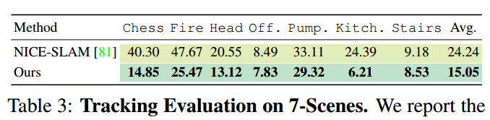
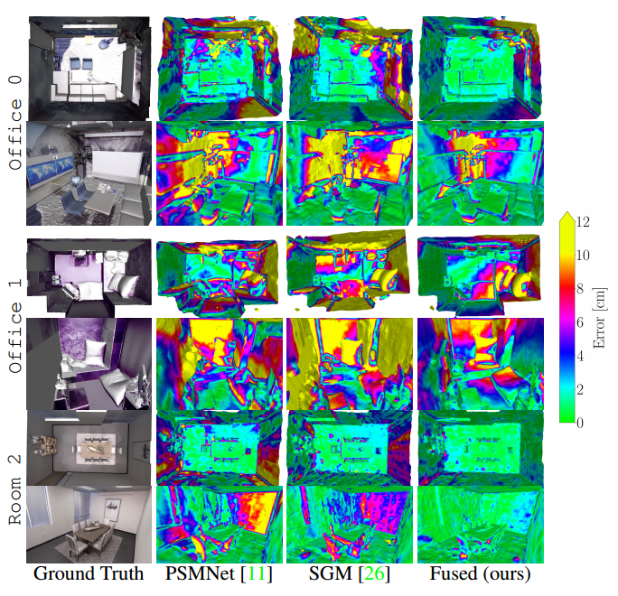
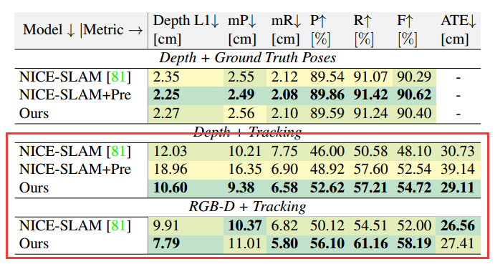
Performance

Slide 6
2
Method

Slide 7
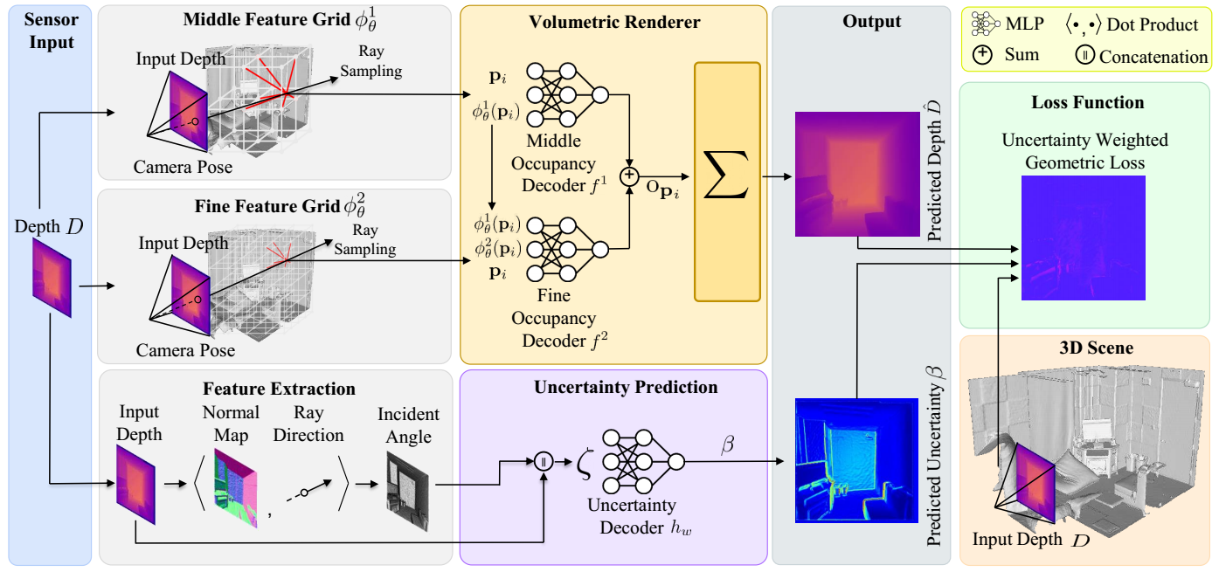
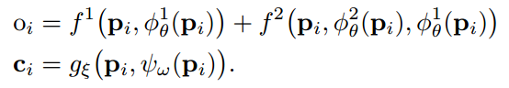
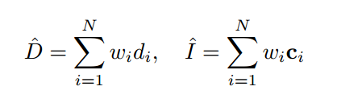
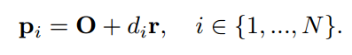
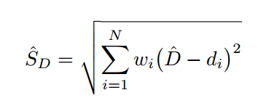
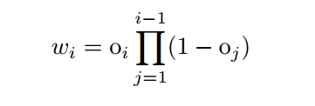
Preliminaries
Inheritde from NICE-SLAM
volume density(occupancy)：

Slide 8
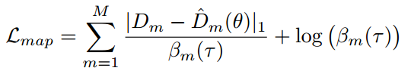
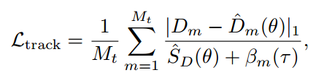
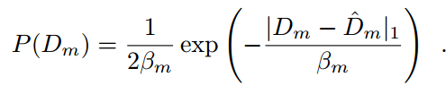
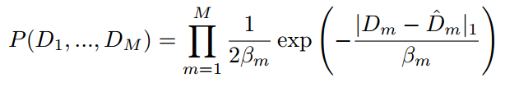
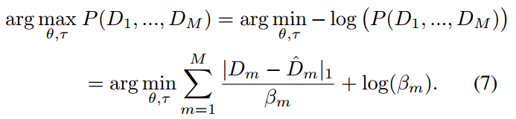
Theoretical Assumptions
Mapping and Tracing
·sensor noise under the assumption of a Laplacian noise distribution on a per-ray basis which was found to perform better on vision tasks than a Gaussian assumption.
·assume that the noise is heteroscedastic meaning that the noise variance is a variable for each pixel.
·each pixel m is independent.
The measured depth is sampled from the probability density function:
Mapping is performed equivalently to NICE-SLAM, but with the revised loss function:
Tracing is similar:
问题：这个模型很好，很有道理，而且适合大数据集，但是为什么很少见有人使用呢？
MLE:
The key of self-supervision

Slide 9
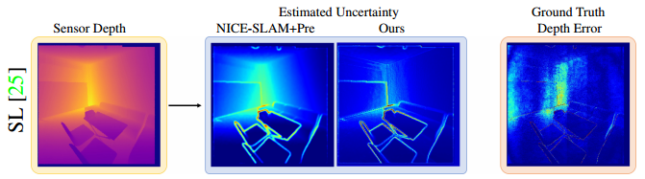
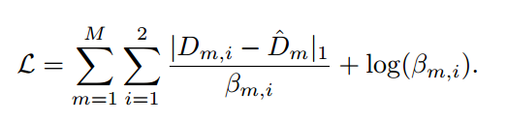
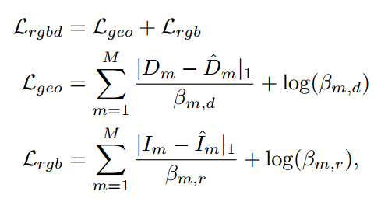
Multi-Sensor Depth Fusion and RGBD Fusion
we again assume that each depth observation is I.I.D.
Given two synchronized and aligned sensors, we can
sample a set of pixels m ∈ {1, ..., M} from two depth sensors yielding the generalized loss function：
One interpretation of this objective function is that the pipeline implicitly learns the weighting between the two sensor observations.
The loss function penalizes large uncertainties via the log terms.
In an analogous fashion, RGBD fusion:
log term:control precision
like NICE-SLAM
question: How to resolve β?

Slide 10
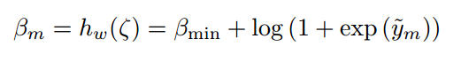
Design Choices and Architecture Details
such an approach is poorly motivated as this calculated variance is related to the model confidence, as opposed to the sensor-specific noise.
So, the author strive to model aleatoric uncertainty.
Strategy:
Inputs:the measured depth D, incident angle θ
Instead of a single pixel, feeding the features from a 5X5 patch.
NeRF-W and softplus activation

Slide 11
3
Experiments

Slide 12
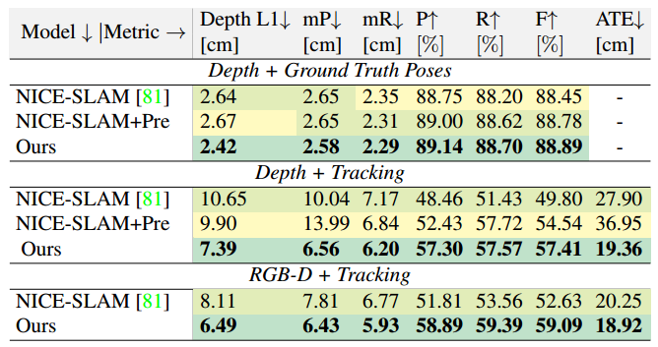
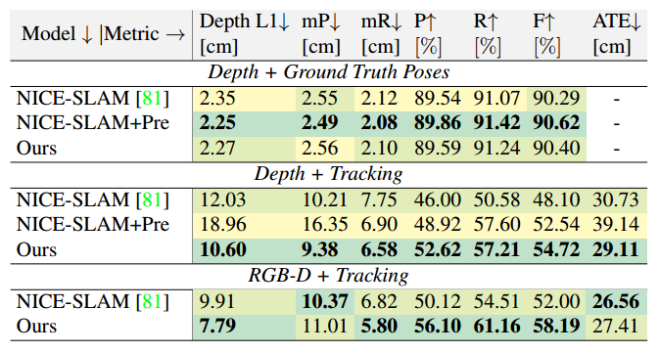
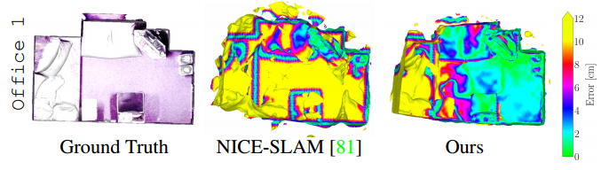
Experiments-single sensor
Replica Database

Slide 13
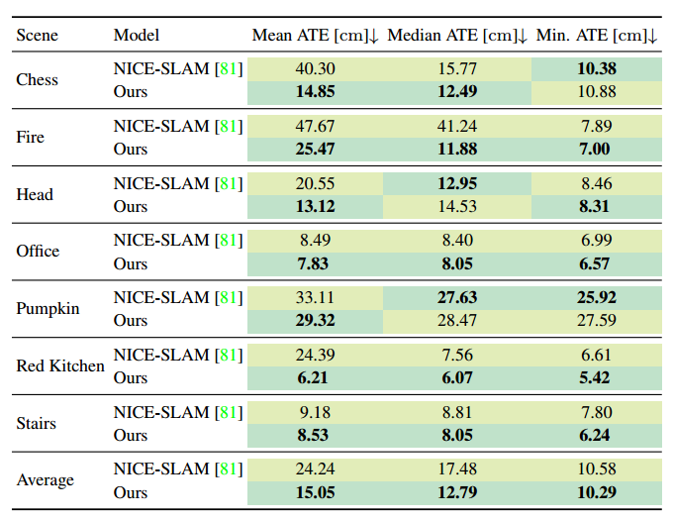
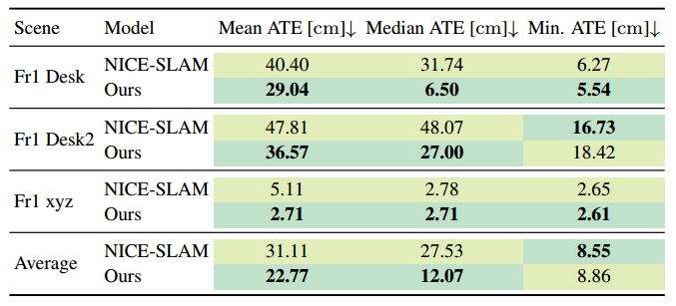
Experiments-single sensor
7-Scenes Database--ATE(38%↑)
TUM RGB-D Database
Benefit by the use of aleatoric uncertainty

Slide 14
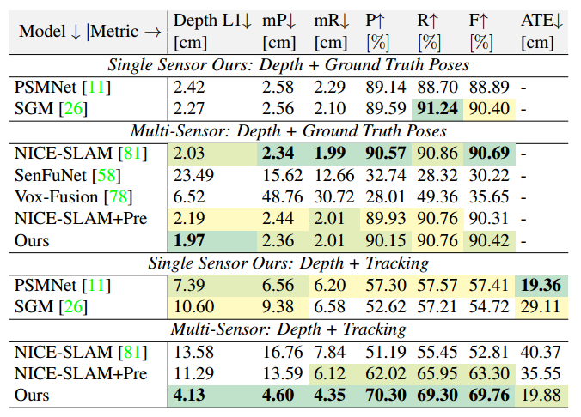
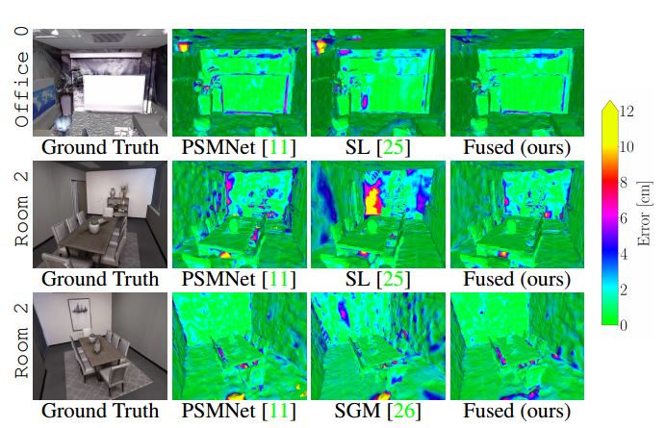
Experiments-multi sensor
single sensor: similar weight
multi sensor: different weight

Slide 15
4
Conclusion

Slide 16
Conclusion
Conclusion and Restriction
Future works:
1. Patch-based modeling of uncertainty which may not hold in the general case.
2. The features used by the decoder of uncertainty may be cheap and simple, but simply using a more expressive model with learned features is not straight forward though, it could introduce additional computation. better feature?
3. Large voxel size can prevent efficient uncertainty learning from fine geometric details. The method can benefit from a scene representation that allows for resolving finer details.
Inspiration:
1. A plenty of investigation: 81 references
2. Numours experiments: read paper
3. The ability of self-supervision: generalization ability
4. Closer to SLAM: the development of Tracing is surprising, but why not compare with traditional SLAM? bad perforance?

Slide 17
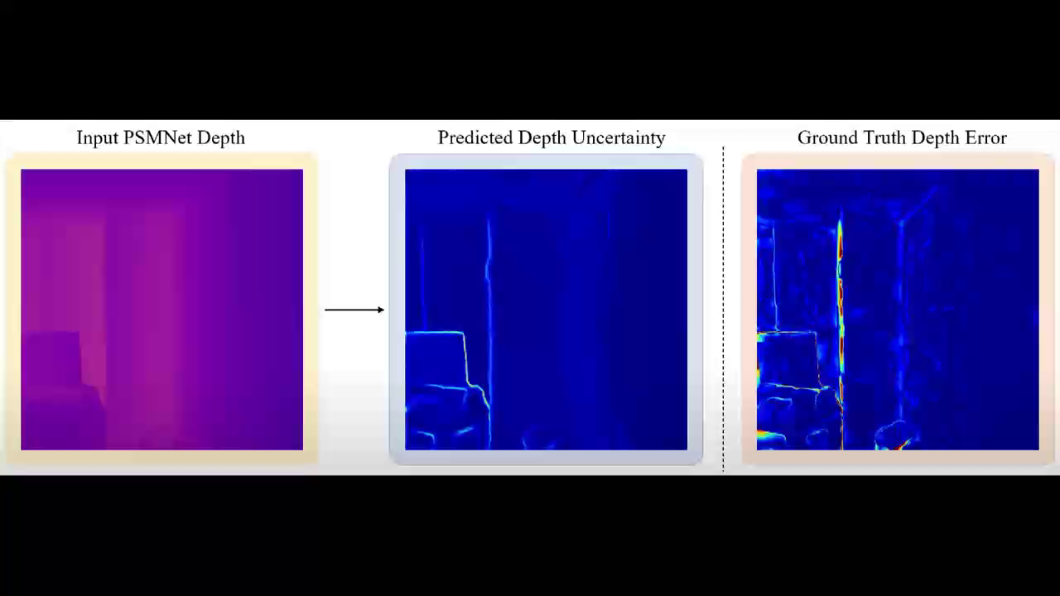
Video

Slide 18


添加V: cv3d007，咨询更多
「3D视觉从入门到精通」知识星球
Notes:
这页注意根据本课程名字修改，以及替换左侧的课程二维码。

Slide 19

欢迎关注3D视觉工坊
公众号
我们这里有3D视觉算法、SLAM、点云处理、三维重建、计算机视觉、深度学习、自动驾驶、图像处理、技术干货以及前沿paper分享！
如果你也想成为主讲人，欢迎加入我们。
请加V：cv3d007，备注：工坊主讲申请
公众号
交流群请添加客服

Slide 20

感谢聆听
Thanks for Listening

